Slide 1
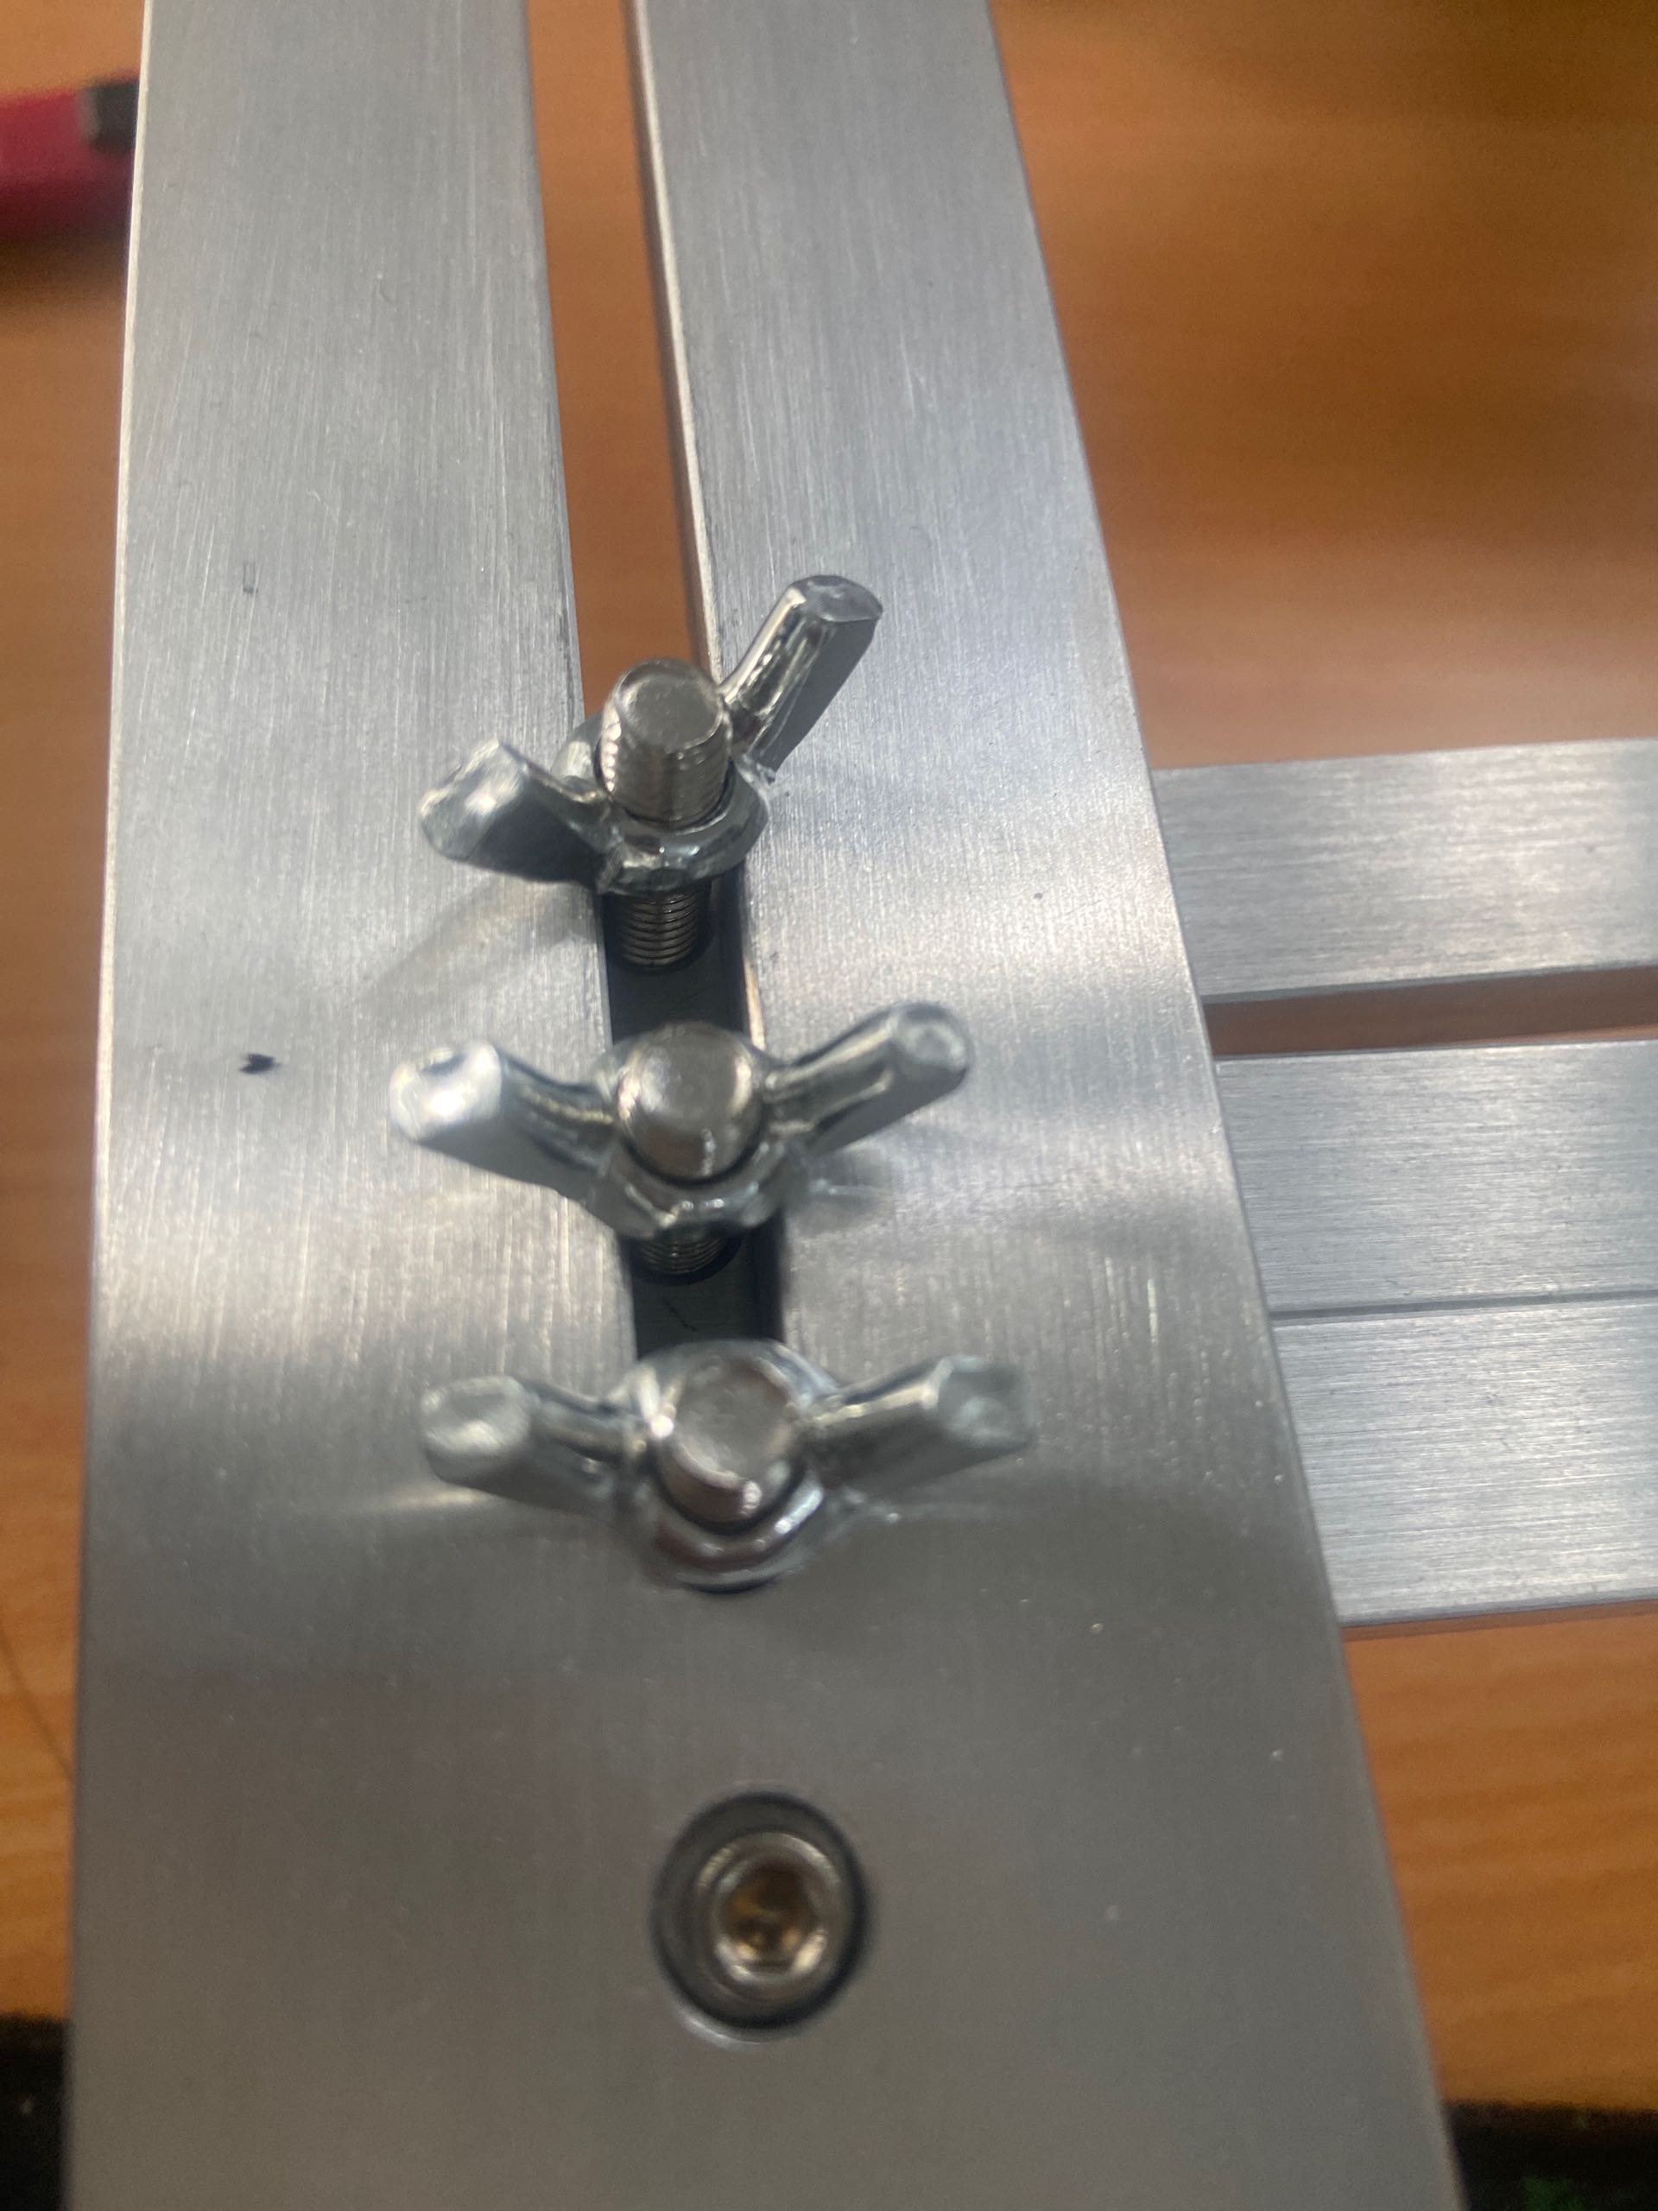
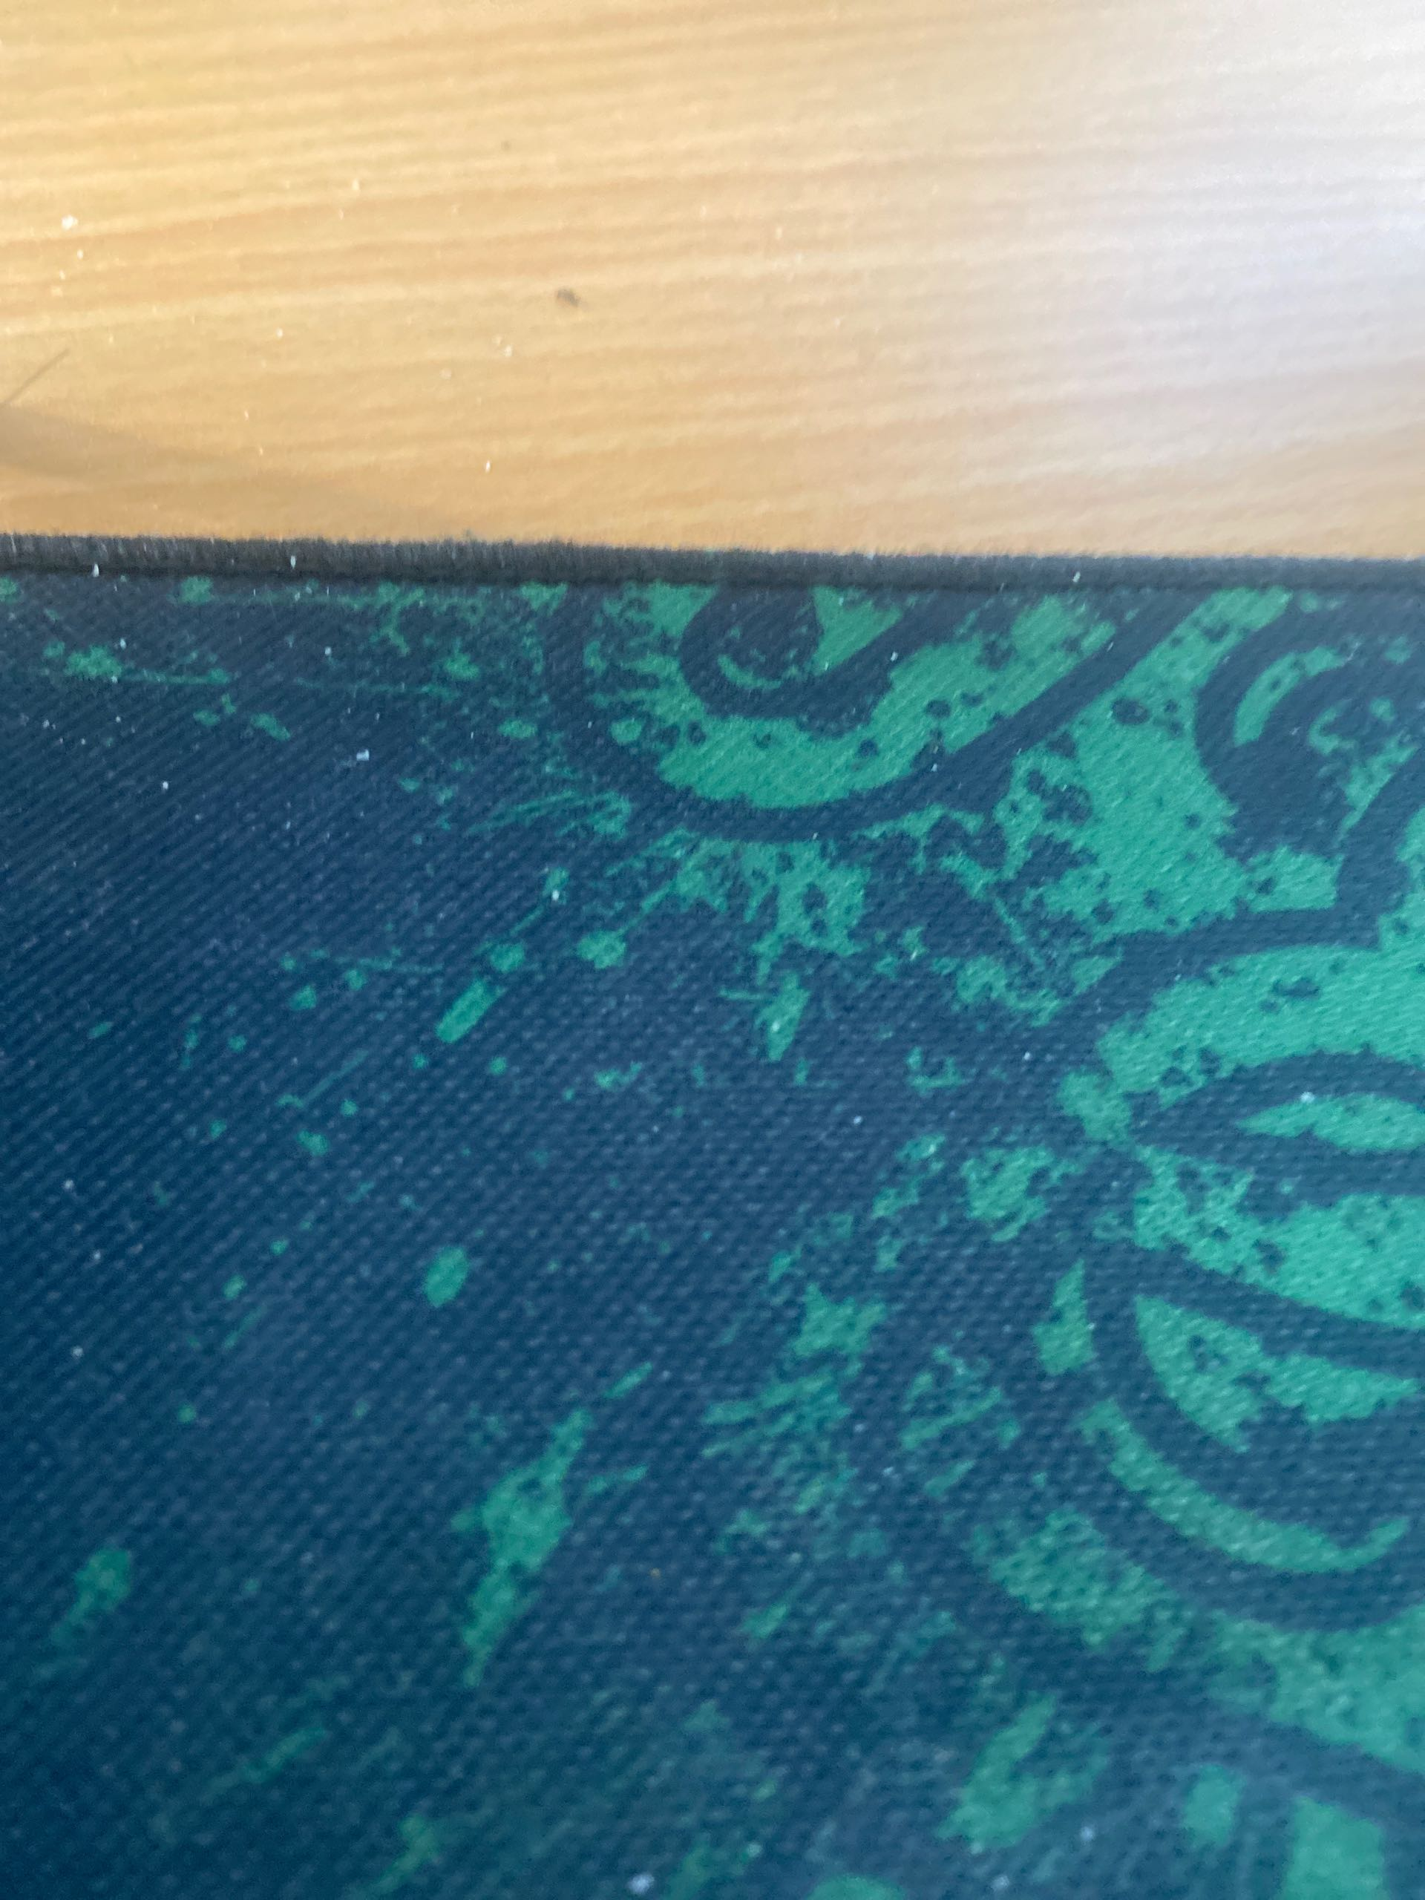
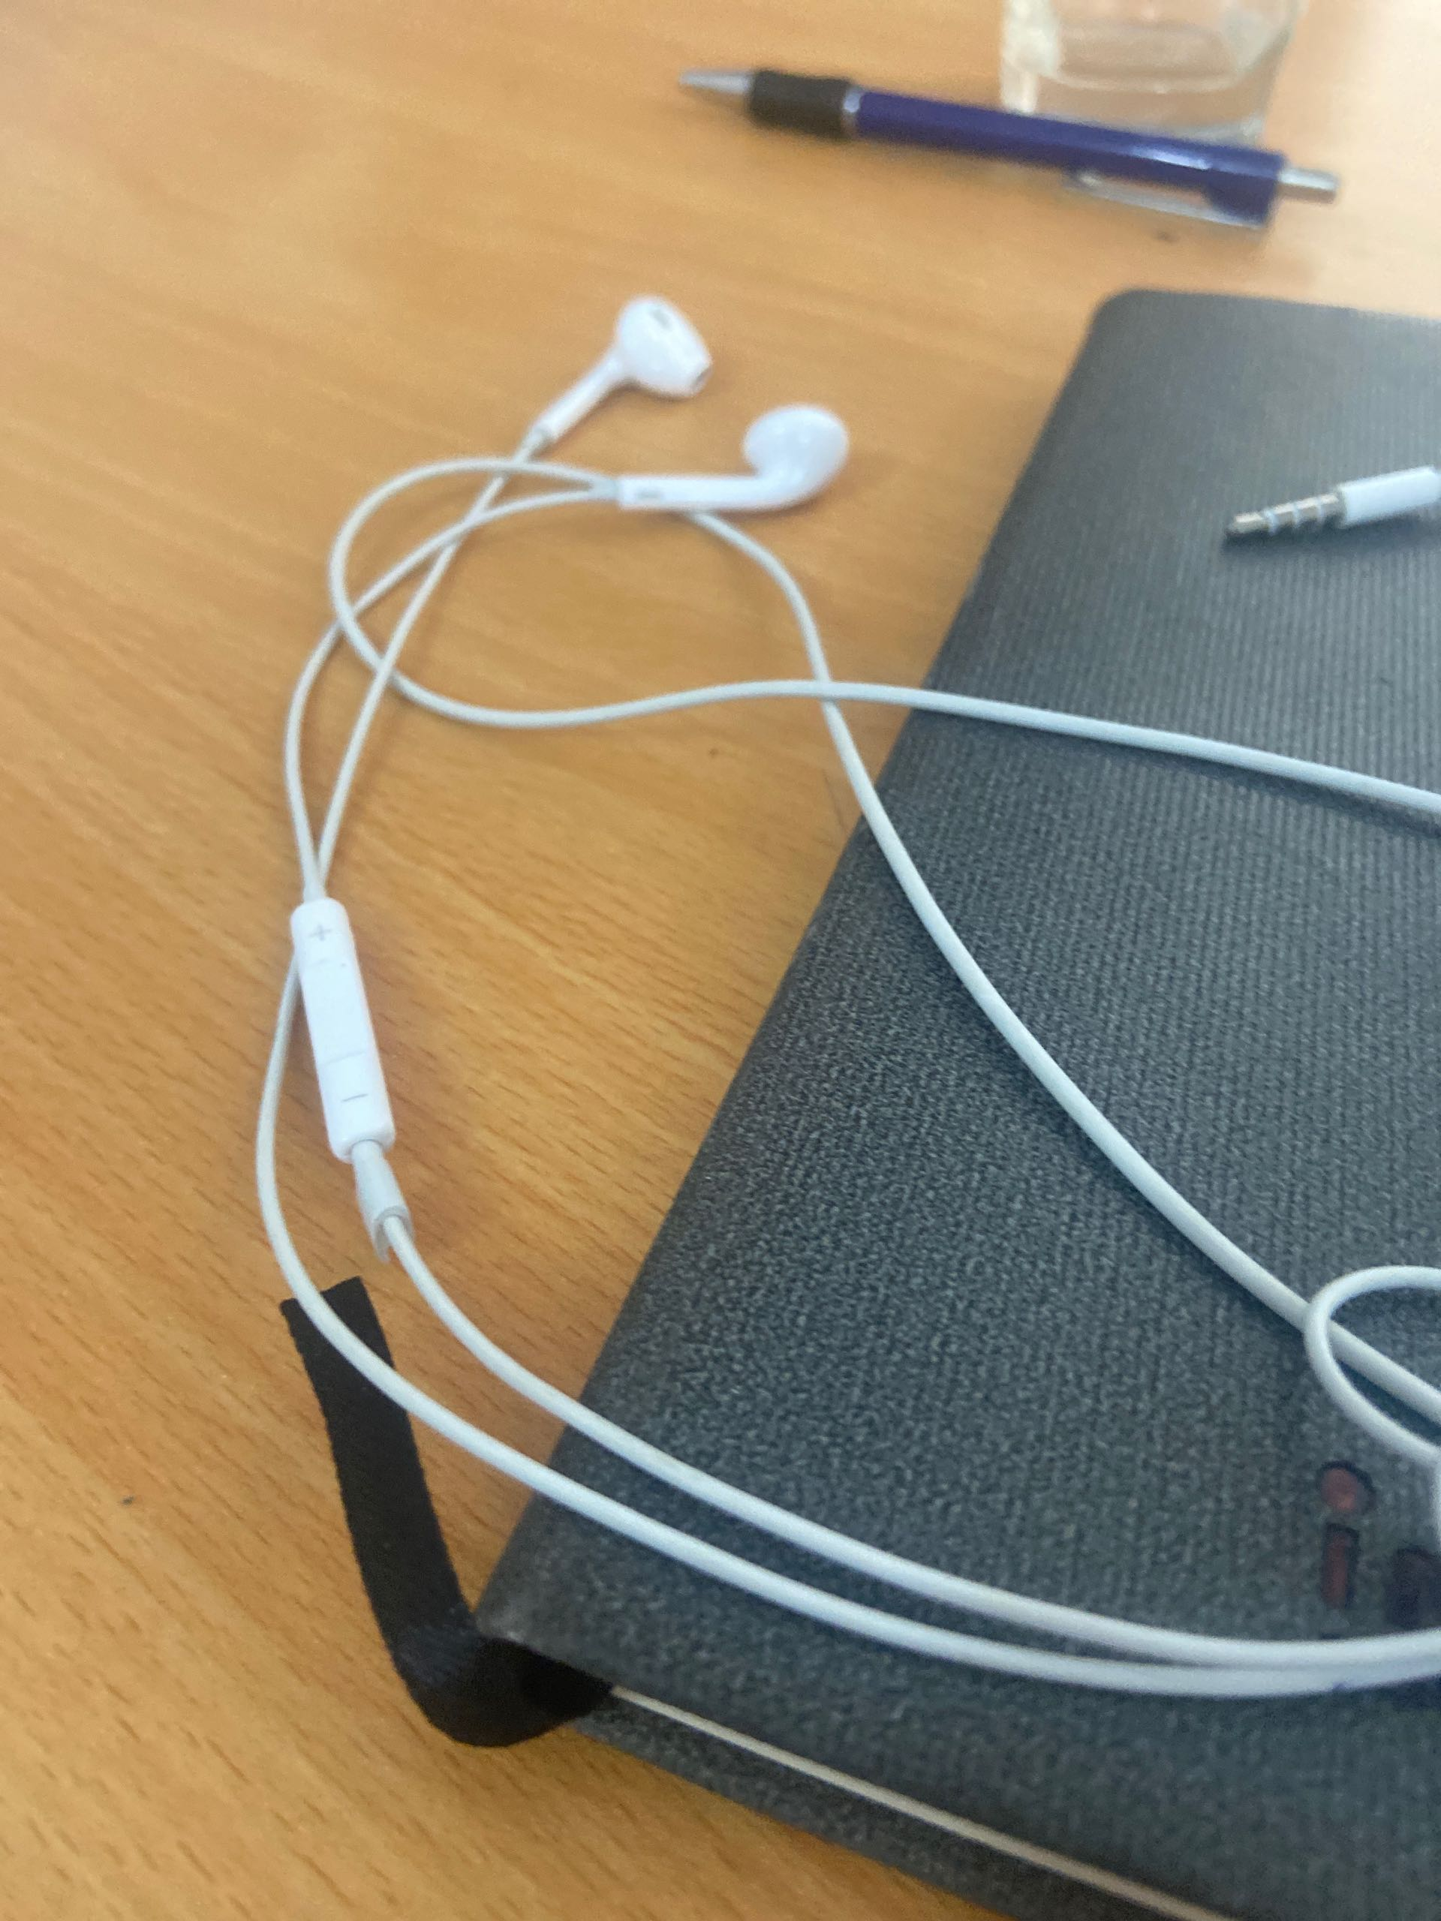
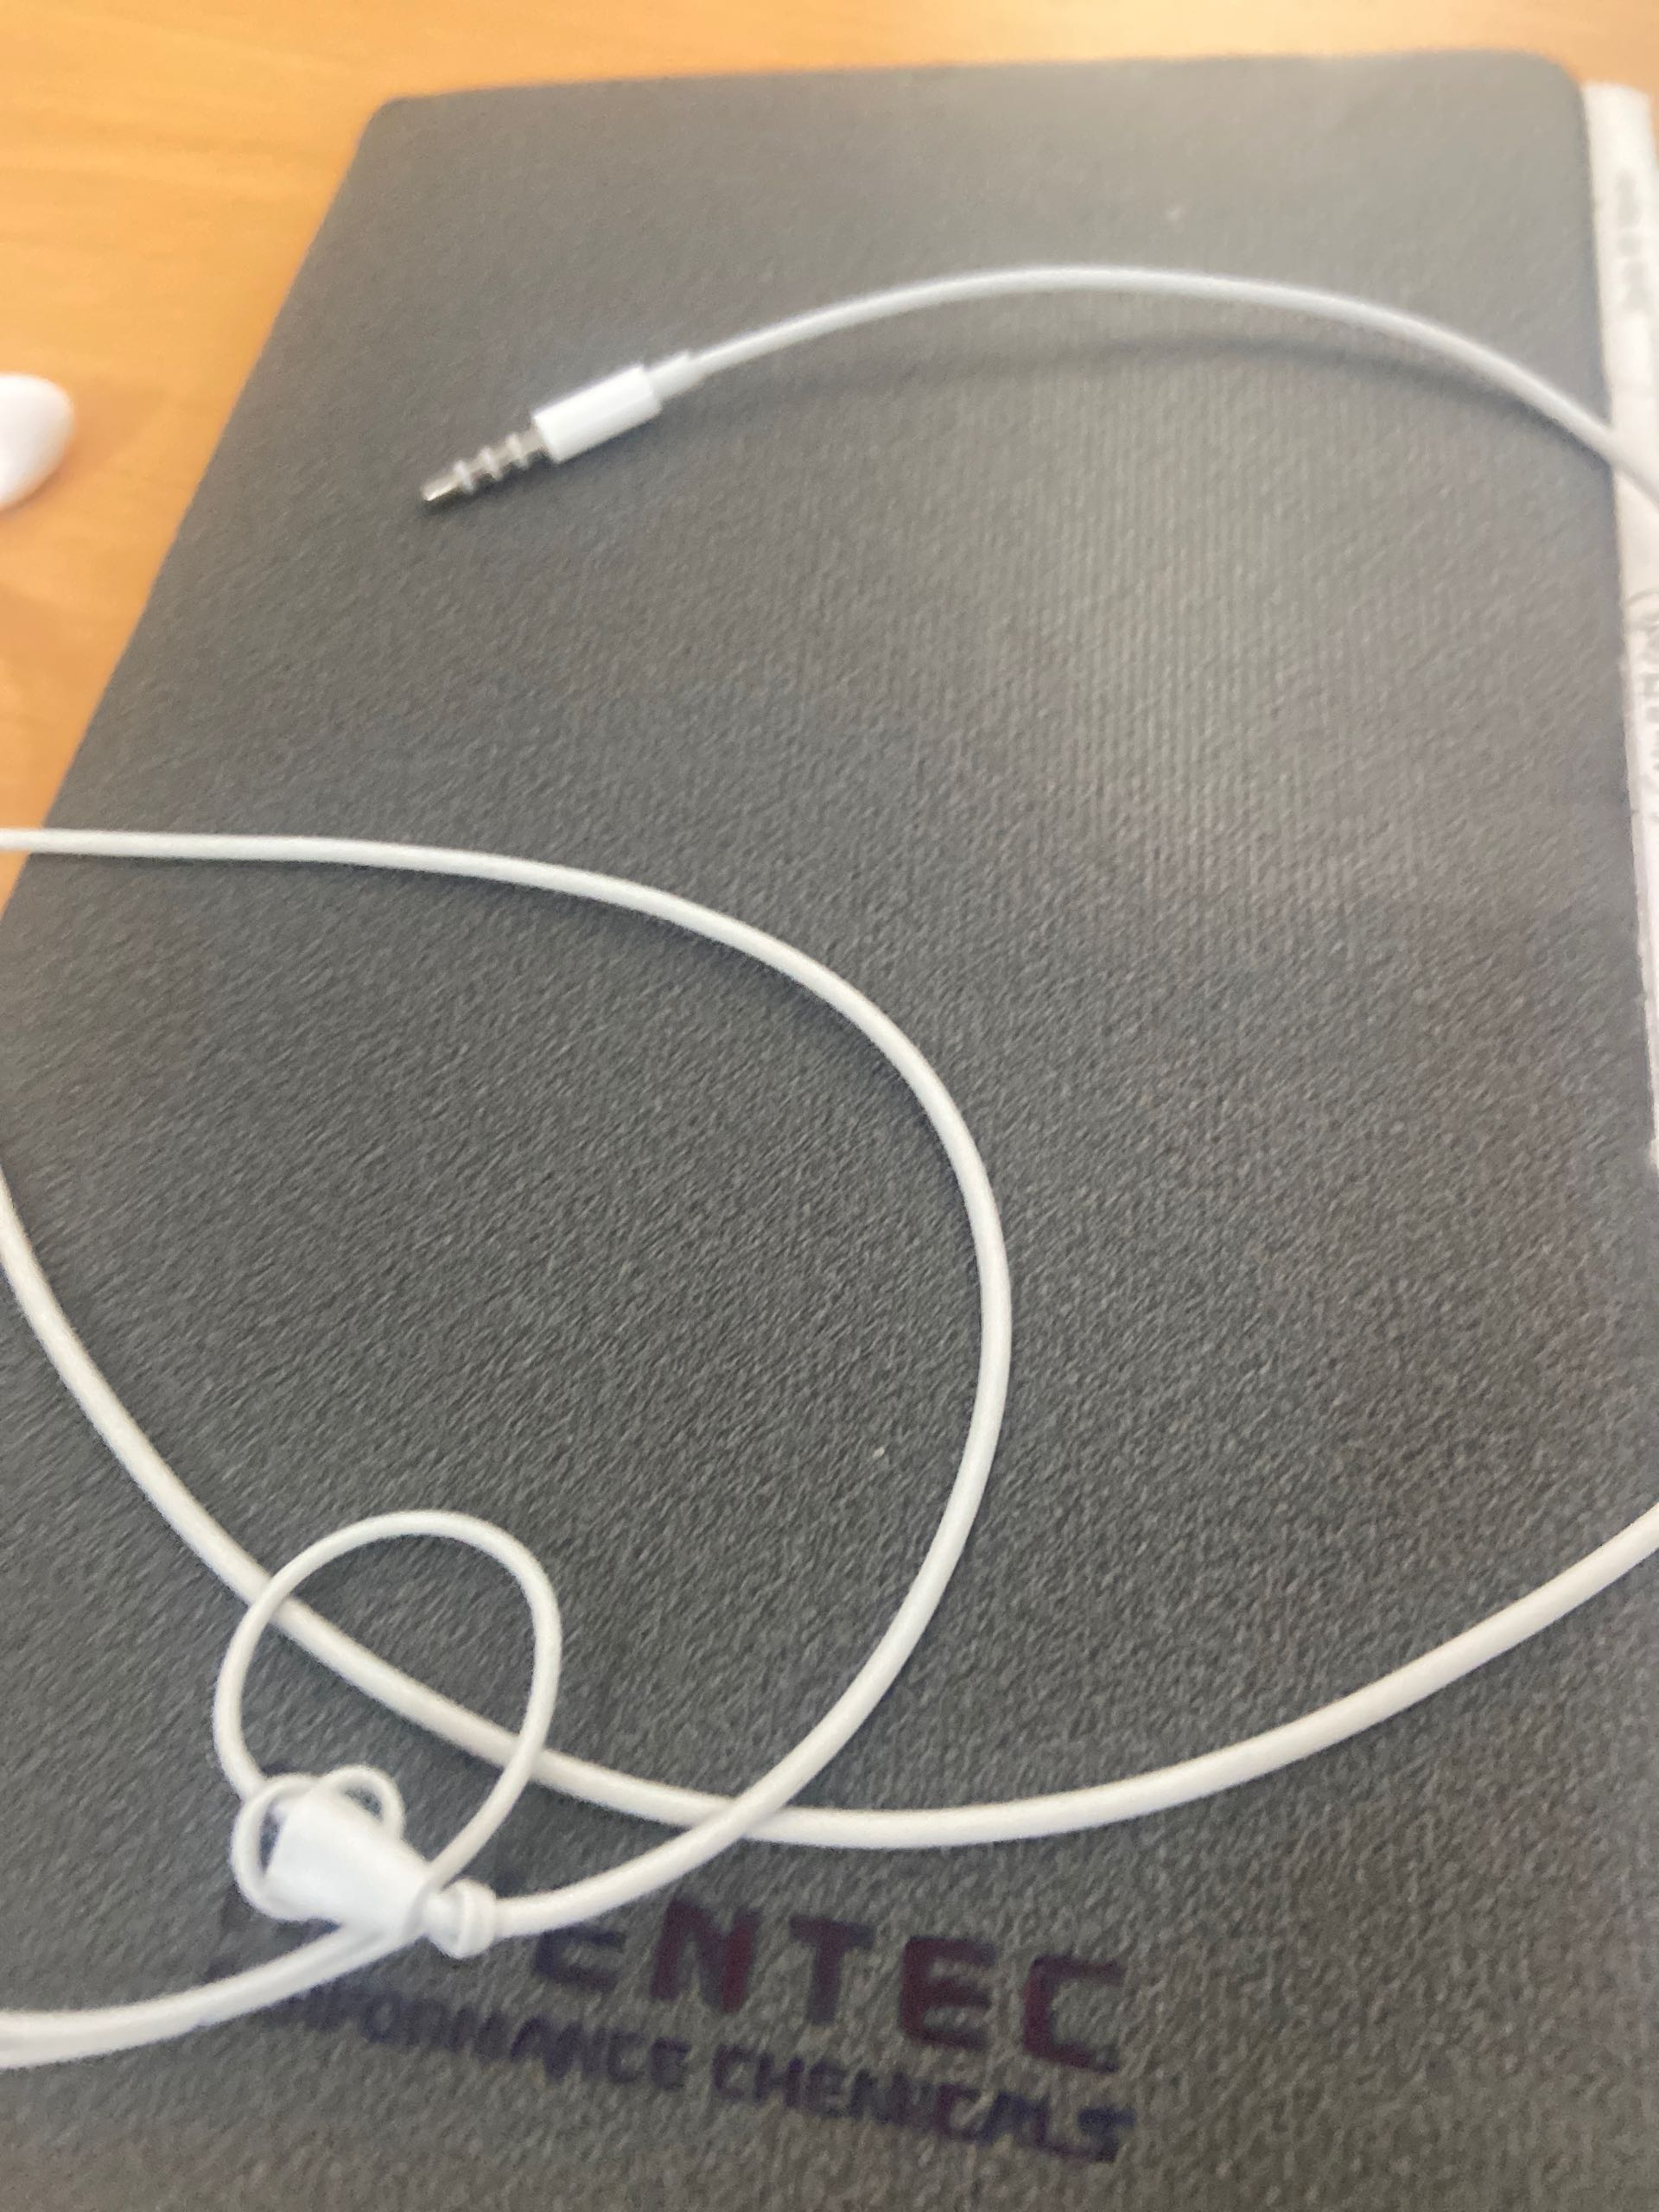
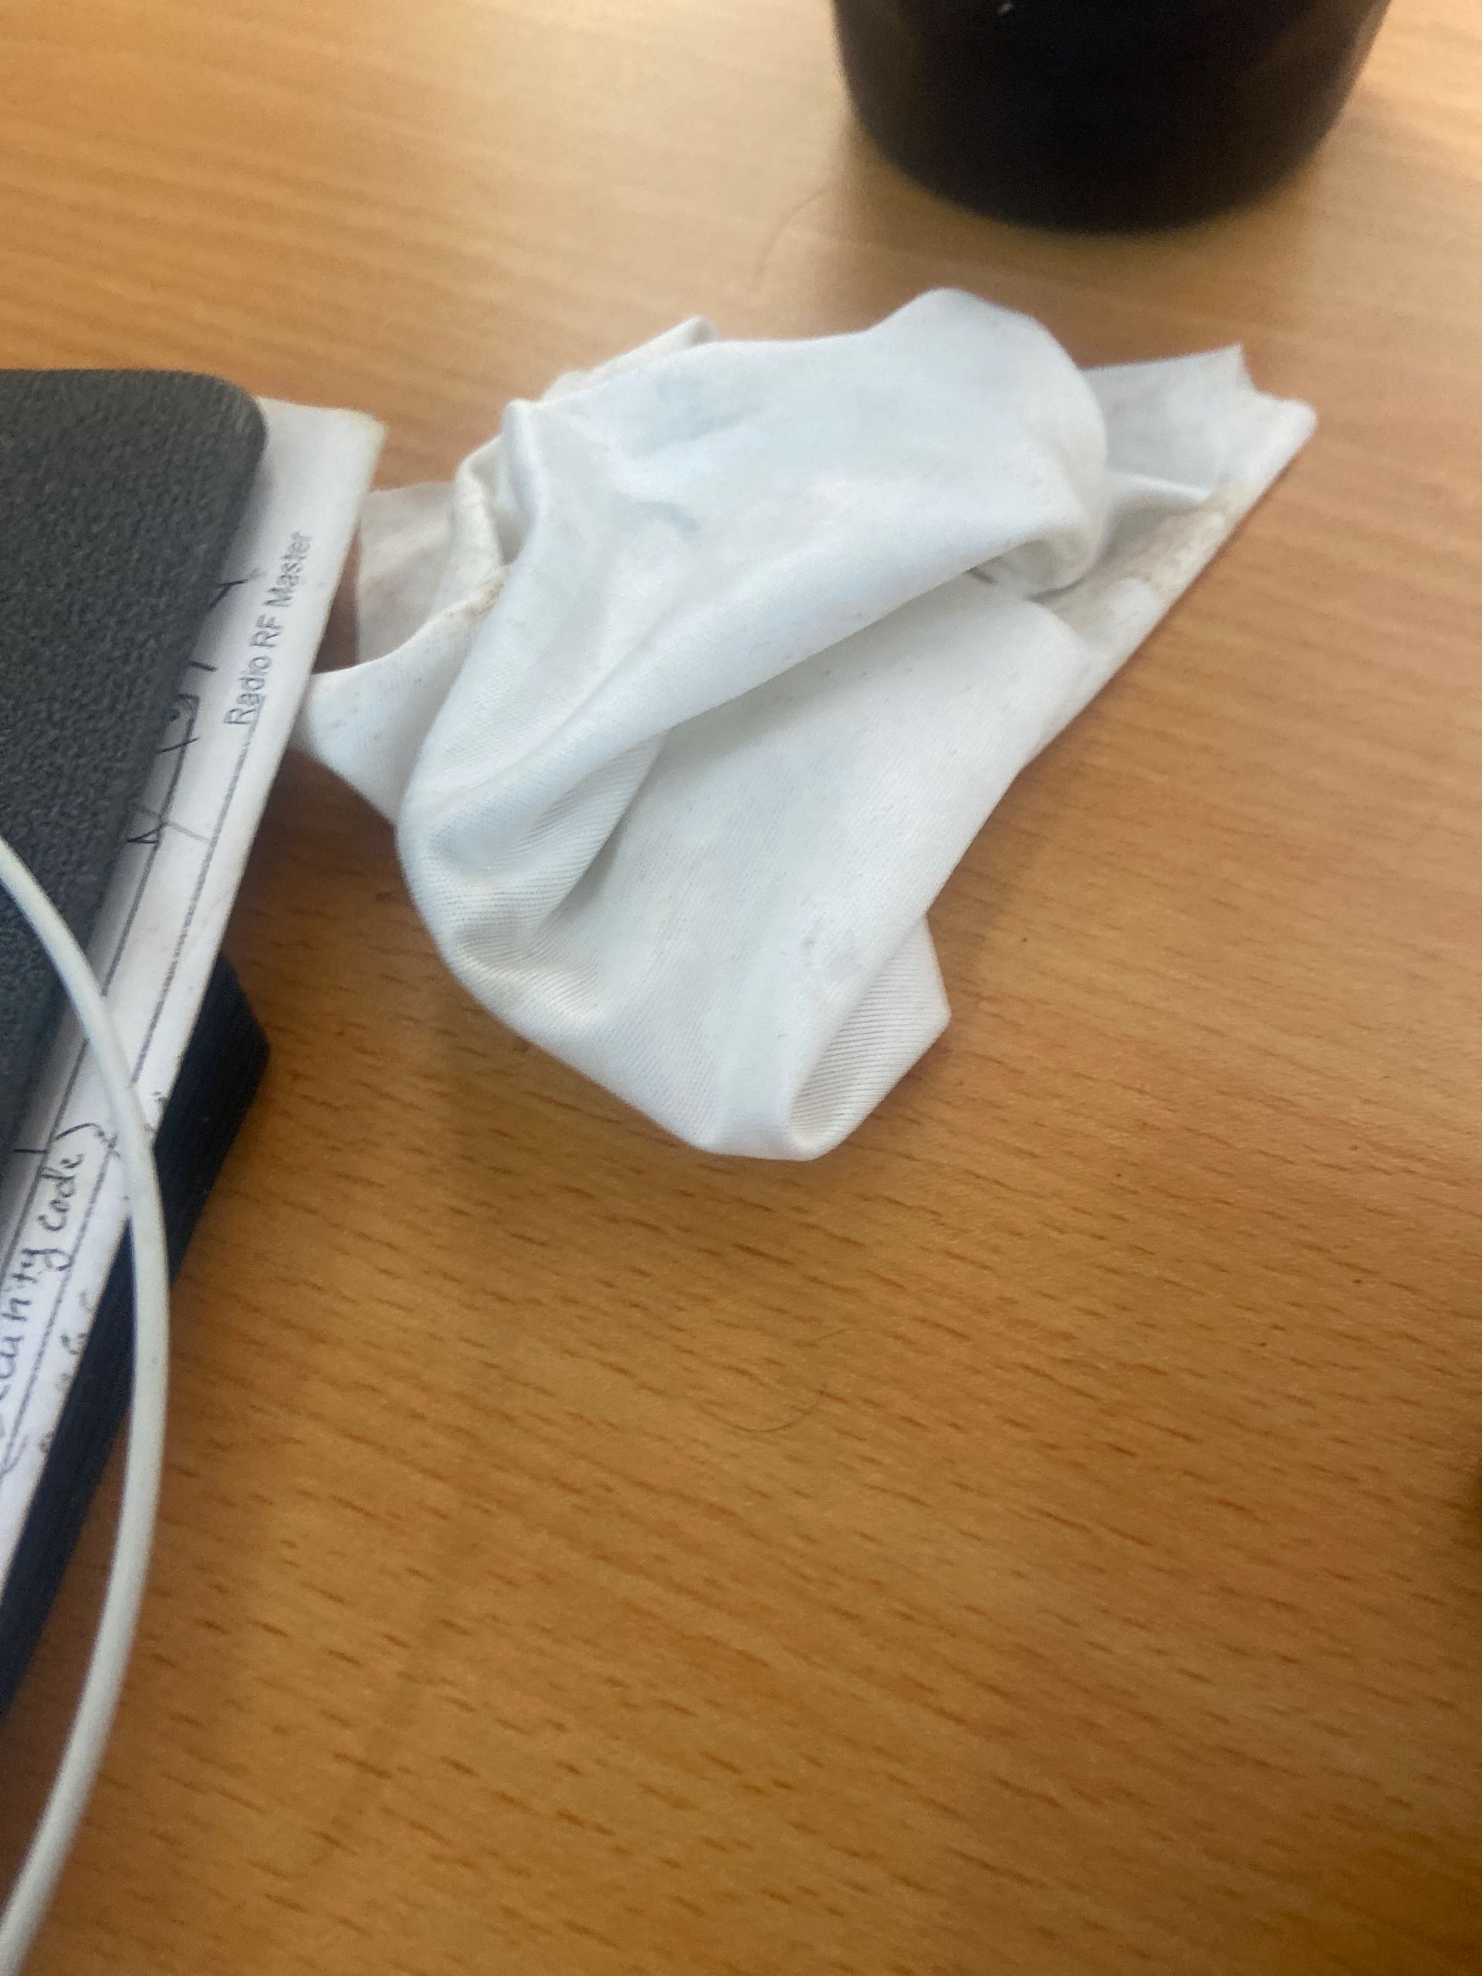
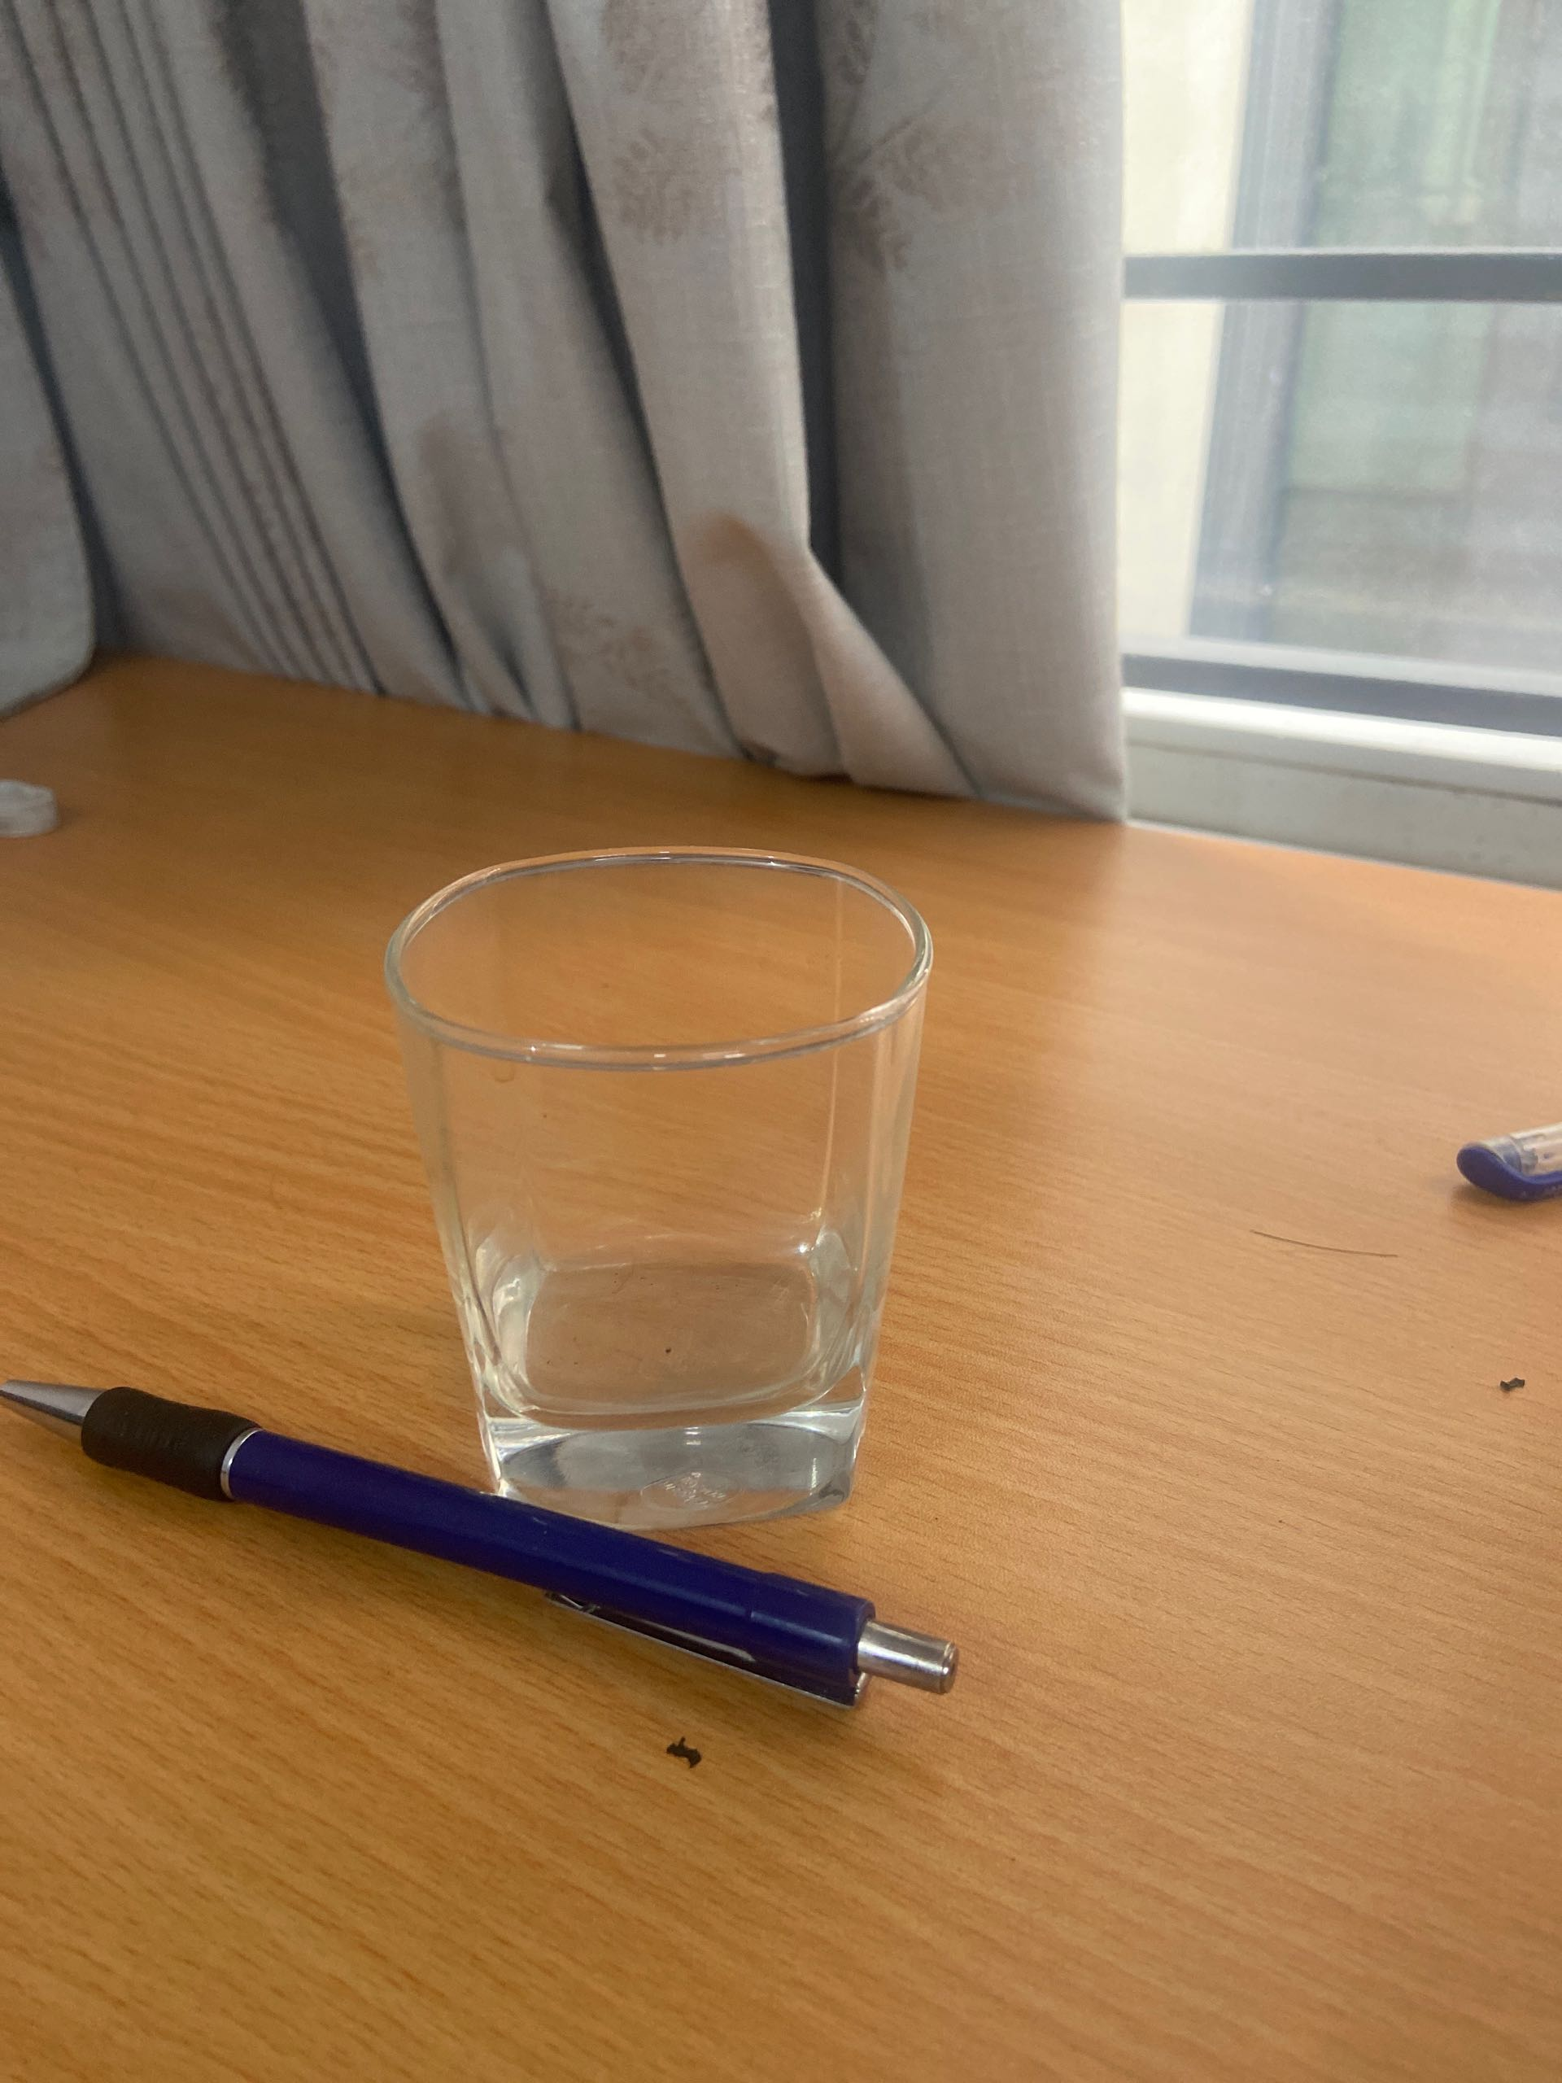
TR20240805_0006
admin
nam part leader
nam leader
MOUNTER J 1.2 TOP
05.08.2024
1
12h42
1
Part detection error.
13h08
1.2-Top
26 Min
During model TSU arise issue " Part detection error" feeder J137.
Remove mark center X deviated from 6.5mm to 6.8mm.
BEFORE
AFFTER
Because part adjust direction mark Center X deviated.
Line running normal.
1/1

